Slide 1
Policy-Based Infrastructure as Code with Kyverno
Kubernetes Community Days Bengaluru
3rd June 2023

Slide 2
Speakers
Kumar Mallikarjuna Software Engineer Nirmata
Shivam Tyagi Contributor
 | @kr_mallikarjuna
 | /kumarmallikarjuna
 | kumar@nirmata.com
 | @twtyagi
 | /shivam-tyagi

Slide 3
Outline
Background
Policy Management
Infrastructure-as-Code (IaC)
Kyverno
Crossplane
Crossplane + Kyverno
Demo
Summary
Q&A

Slide 4
Background: Policy Management
Policy
Policies define what can and cannot be done on a cluster
Thus ensuring:
Security
Compliance
Best practices
Policy Engines
Policy Engines apply policies on the cluster
Examples:
Kyverno
OPA
jsPolicy
1 apiVersion: kyverno.io/v1
2 kind: ClusterPolicy
3 metadata:
4 name: disallow-latest-tag
5 spec:
6 validationFailureAction: audit
7 background: true
8 rules:
9 - name: validate-image-tag
10 match:
11 ¦ any:
12 ¦ - resources:
13 ¦ ¦ kinds:
14 ¦ ¦ - Pod
15 validate:
16 ¦ message: "Using a mutable image tag e.g. 'latest' is not allowed."
17 ¦ pattern:
18 ¦ spec:
19 ¦ ¦ containers:
20 ¦ ¦ - image: "!*:latest"
Sample Image Verification Policy [1]

Slide 5
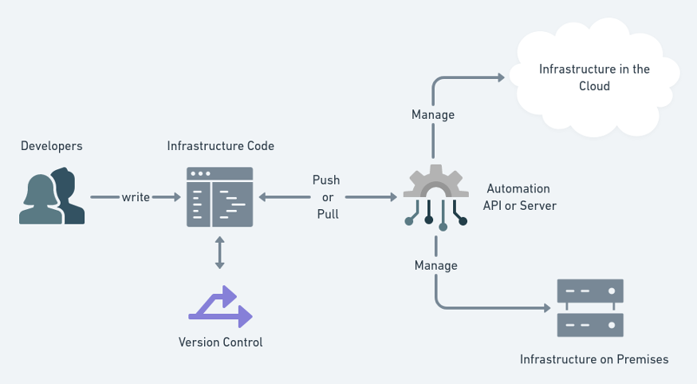
Background: Infrastructure-as-Code (IaC)
What is IaC?
Managing and provisioning of infrastructure through code instead of through hardware/interactive configuration tools
Tools:
Terraform
Crossplane*
Pulumi
Advantages
Cost reduction
Increase in speed of deployments
Reduce errors
Improve infrastructure consistency
Eliminate configuration drift
Infrastructure as Code Workflow [2]

Slide 6
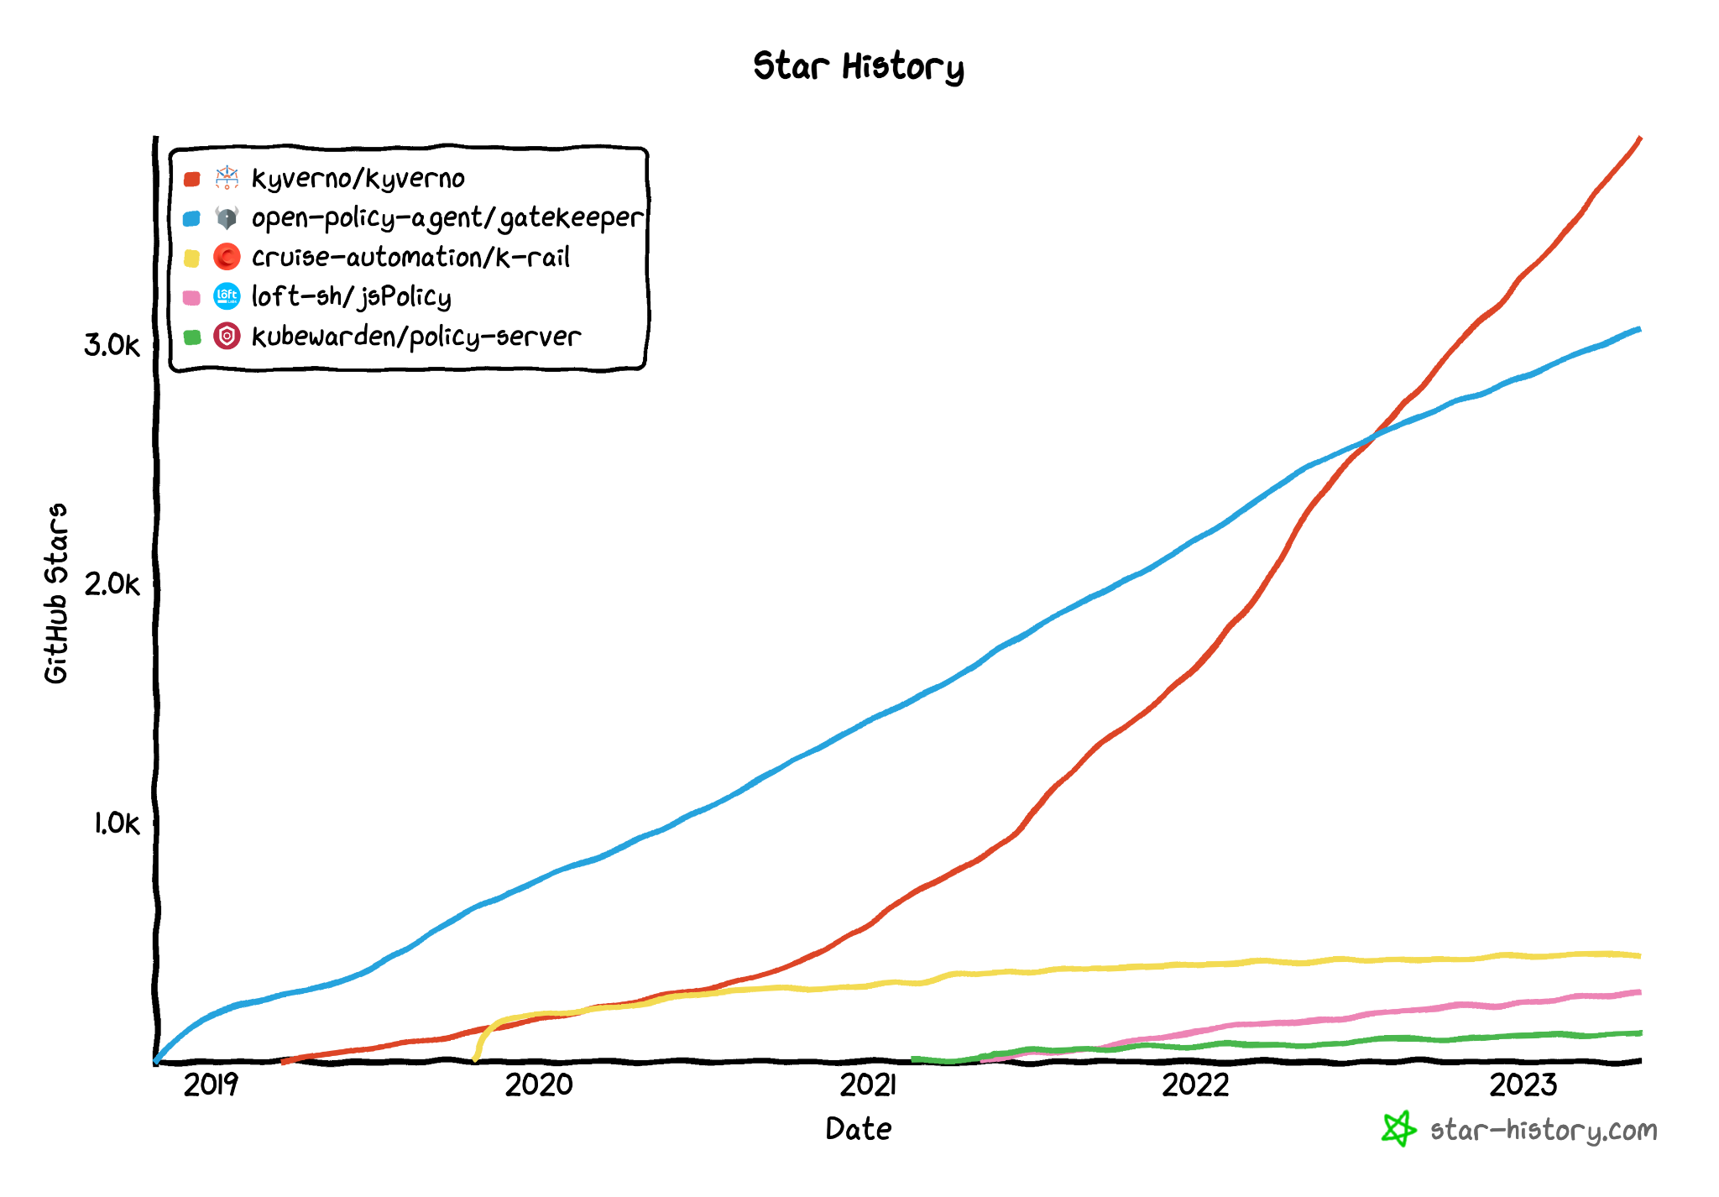
Kyverno
Why Kyverno?
CNCF Incubating
YAML-based policies
Kubernetes-native
Supports all Kubernetes resources including Custom Resources
Most starred Kubernetes Policy Engine
Largest policy library of any engine
Allows integration into CI/CD pipelines
Report generation
Stats:
Over 3.9k stars on GitHub
More than 1.6 billion image pulls
Kyverno Star History [3]

Slide 8
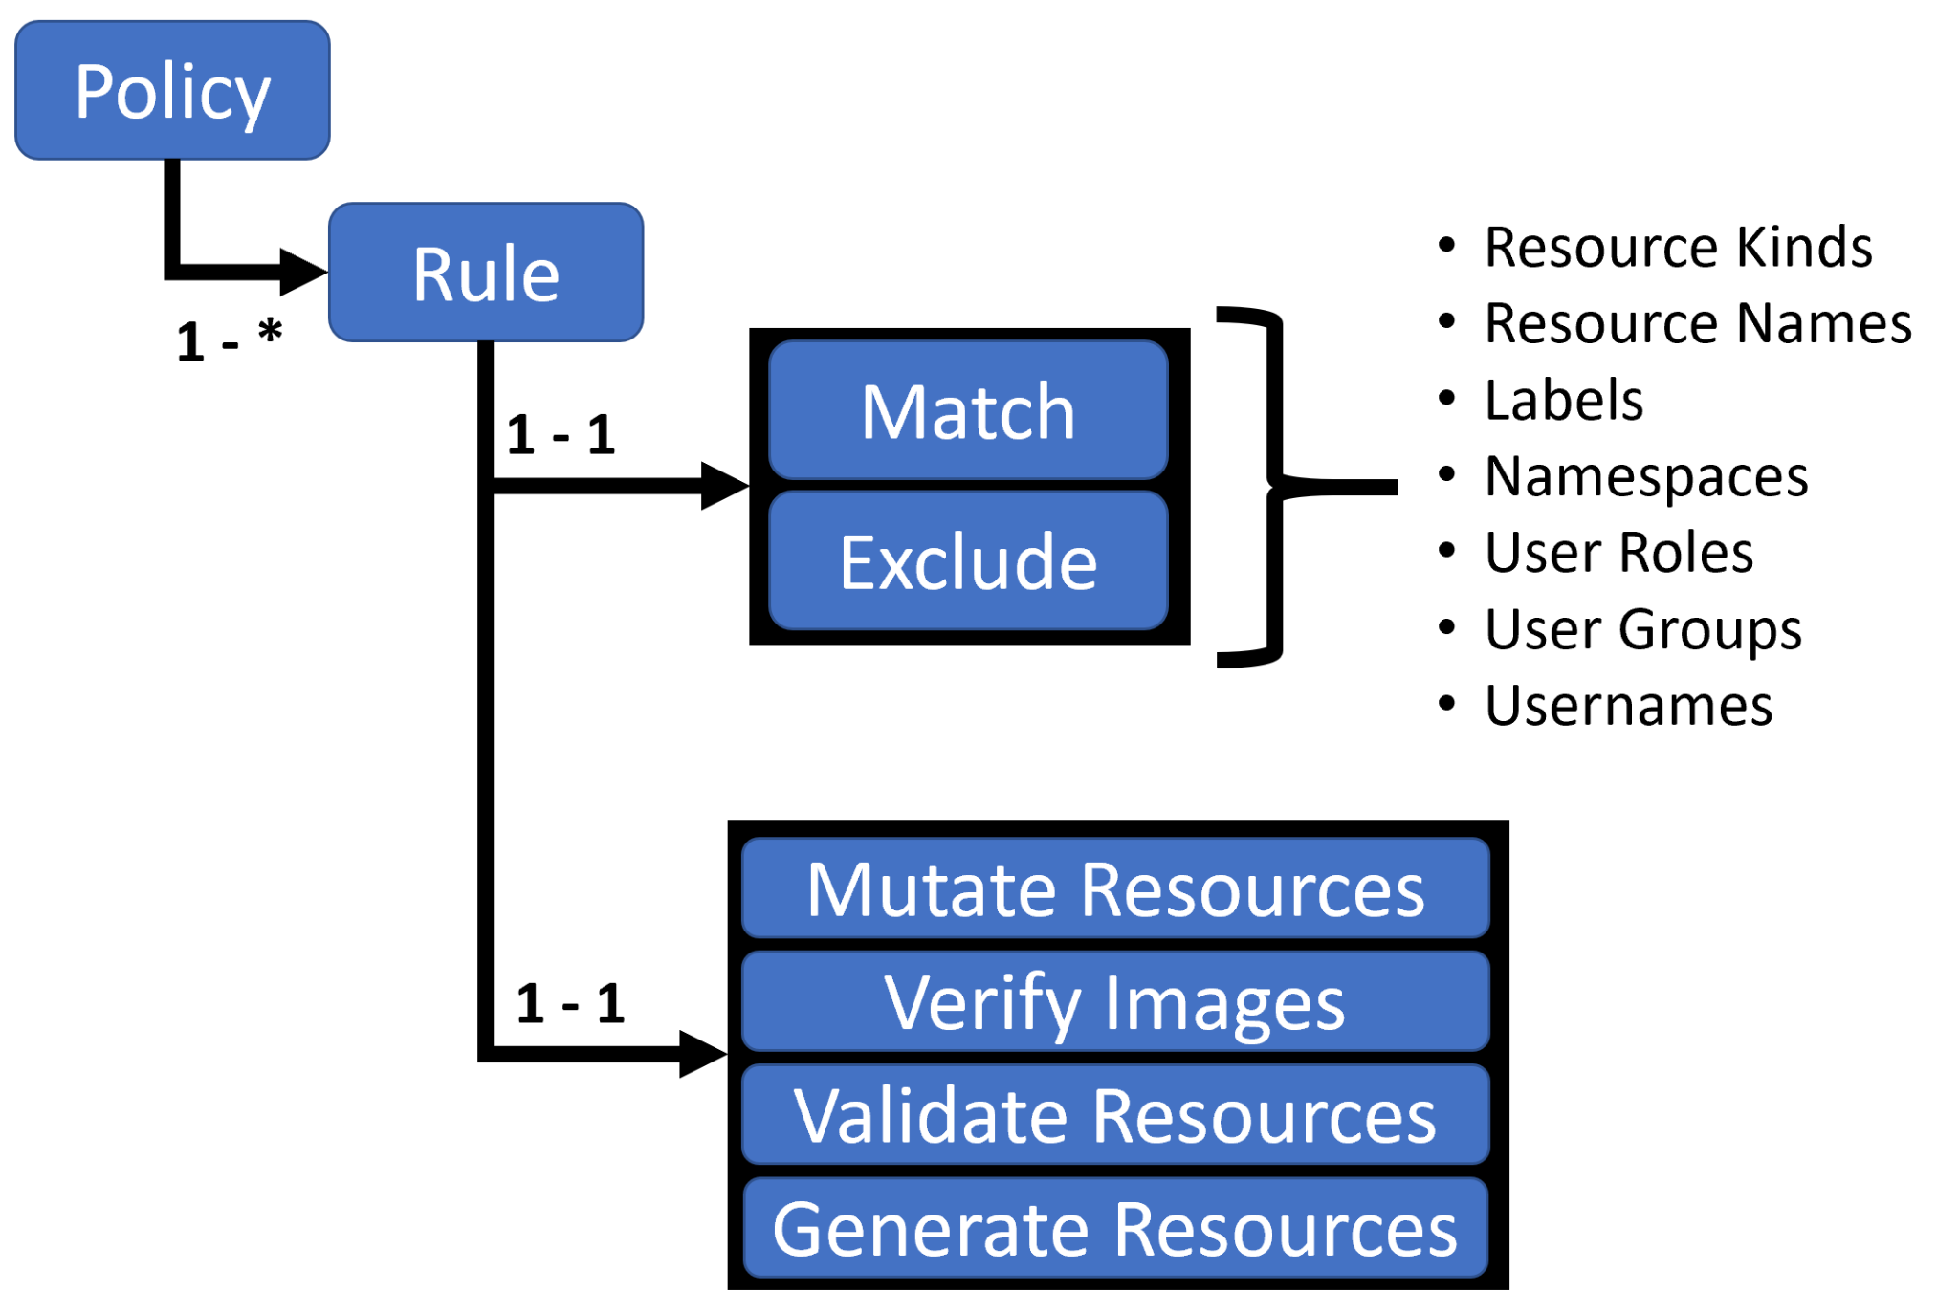
Kyverno: Use Cases
Pod Security
Multi-tenancy (Namespace provisioning)
Supply chain security
Fine-grained RBAC
Sidecar injection with mounts, etc.
And much more… see https://kyverno.io/policies/
Kyverno Policies and Rules [4]

Slide 9
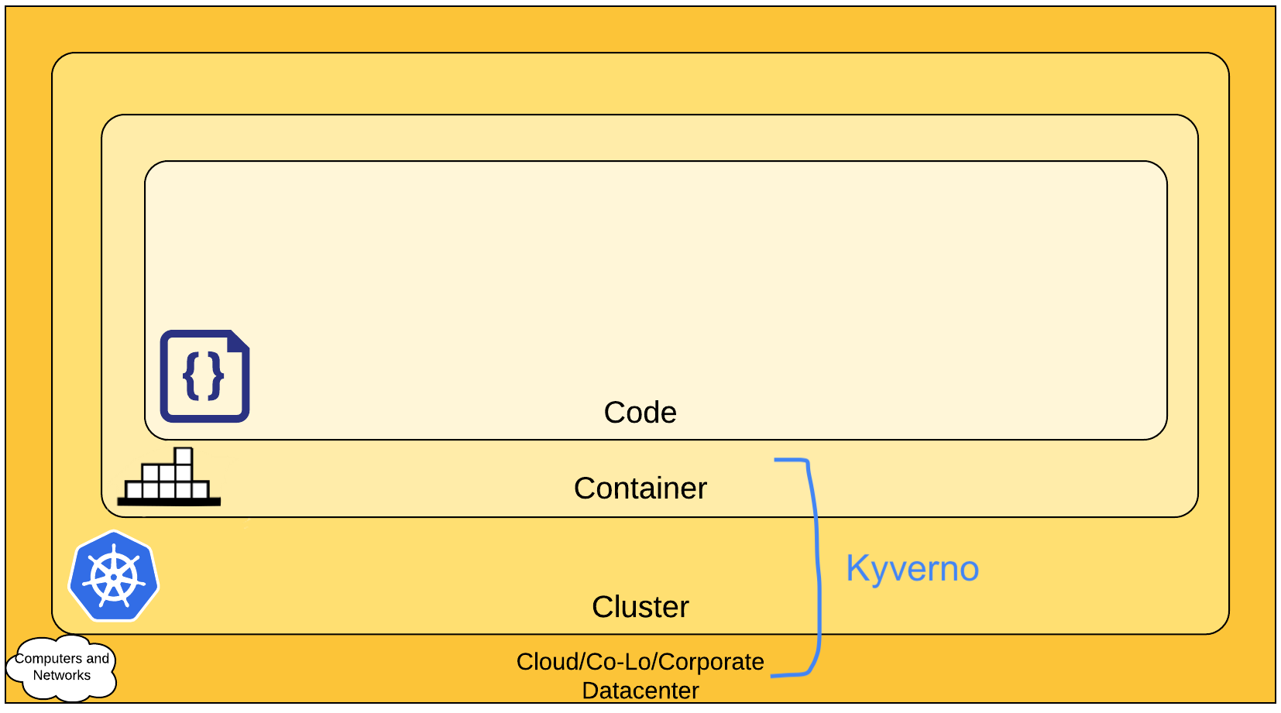
Kyverno: Scope
The 4C’s of Cloud Native Security [5]

Slide 10
Crossplane
CNCF Incubating
YAML-based cloud resource definitions
Kubernetes-native
Supports:
AWS
Azure
GCP
More…
Uses Kubernetes controllers to provision and reconcile infrastructure
Can create new abstractions and APIs
Allows security and compliance enforcement across resources or clouds, without exposing any complexity to the developers

Slide 11
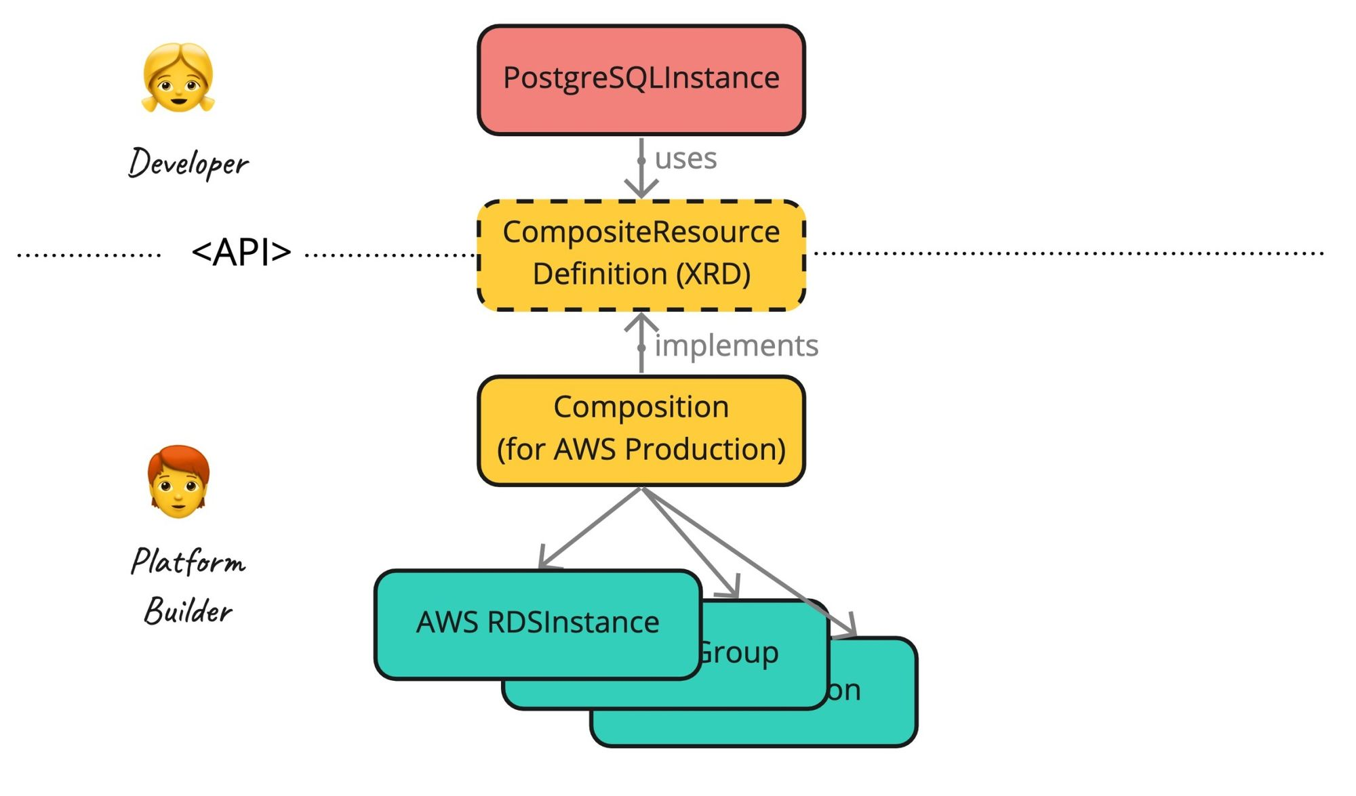
Crossplane: Self-service
Compositions abstract all the infrastructure requirements need to create cloud resources in a self-service model, hiding the infrastructure complexity
Example: When creating a cloud database instance, complexity associated with creating required resources such as virtual private networks, subnets, security groups, can be abstracted.
Crossplane Compositions [6]

Slide 12
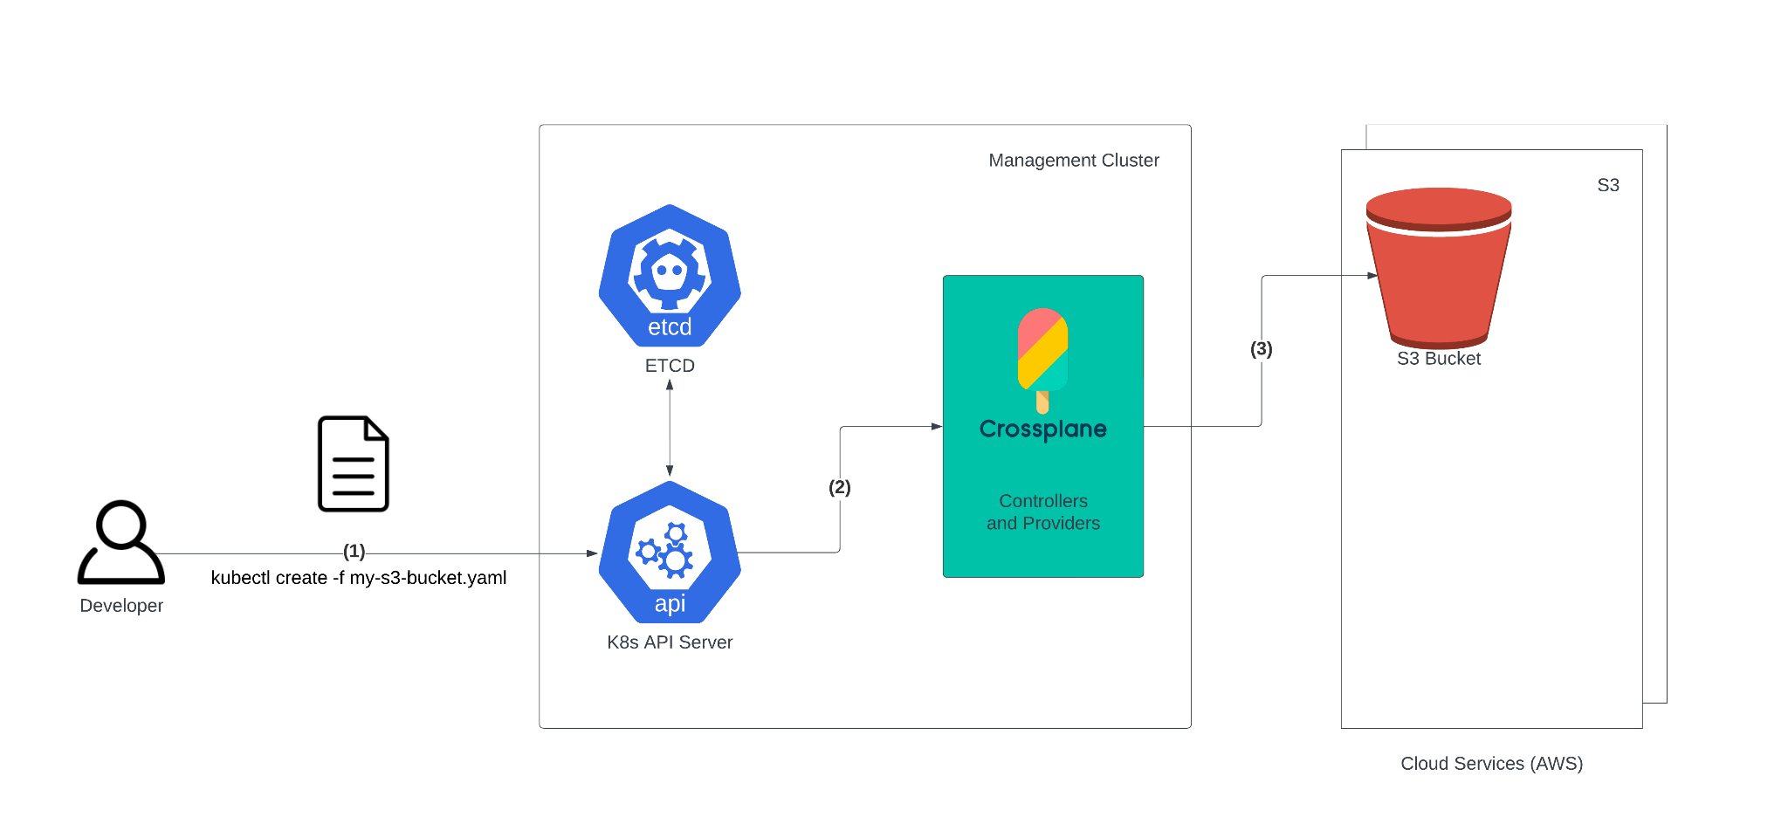
Crossplane: Self-service

Slide 13
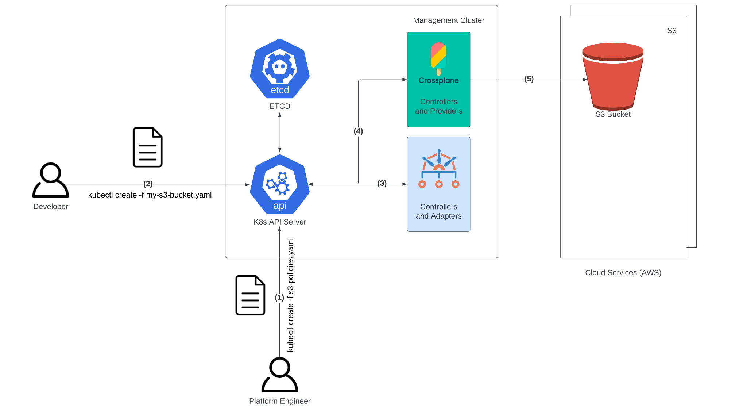
Crossplane + Kyverno

Slide 14
Demo

Slide 15
Summary
Kubernetes based cloud controllers such as Crossplane can enable developer self-service
Kubernetes-native policy engines such as Kyverno can provide the necessary policy enforcement
Proactively enforcing policies prevent misconfigurations, improve security posture and save costs

Slide 16
Join the Community!
Kyverno
Docs https://kyverno.io
Policy Library https://kyverno.io/policies
Playground https://playground.kyverno.io
Slack https://slack.k8s.io/#kyverno
Twitter @kyverno
Crossplane
Docs https://www.crossplane.io
Slack https://slack.k8s.io/#crossplane
Twitter @crossplane_io

Slide 17
Thank you!
try.nirmata.io

Slide 18
References
Kyverno. (2023, January 17). Verify Images. Kyverno. Retrieved May 27, 2023, from https://kyverno.io/docs/writing-policies/verify-images/#verifying-image-signatures
Huawei. (2020, February 10). Kubernetes Cluster Provisioning using Crossplane. InfraCloud. Retrieved May 28, 2023, from https://www.infracloud.io/blogs/cluster-provisioning-using-crossplane/
Start History. (n.d.). Kyverno Star History. GitHub Star History. Retrieved May 27, 2023, from https://star-history.com/#kyverno/kyverno&open-policy-agent/gatekeeper&cruise-automation/k-rail&loft-sh/jsPolicy&kubewarden/policy-server&Date
Kyverno. (2023, January 17). Policies and Rules. Kyverno. Retrieved May 27, 2023, from https://kyverno.io/docs/kyverno-policies/
Kubernetes. (2022, September 3). Overview of Cloud Native Security. Kubernetes. Retrieved May 30, 2023, from https://kubernetes.io/docs/concepts/security/overview/
Luebken, M. (2021, July 7). Why Crossplane Is so Exciting. The Crossplane Blog. Retrieved May 31, 2023, from https://blog.crossplane.io/why-crossplane-is-so-exciting/
Kyverno. (2023, May 12). Introduction. Kyverno. Retrieved June 1, 2023, from https://kyverno.io/docs/introduction/

Slide 19
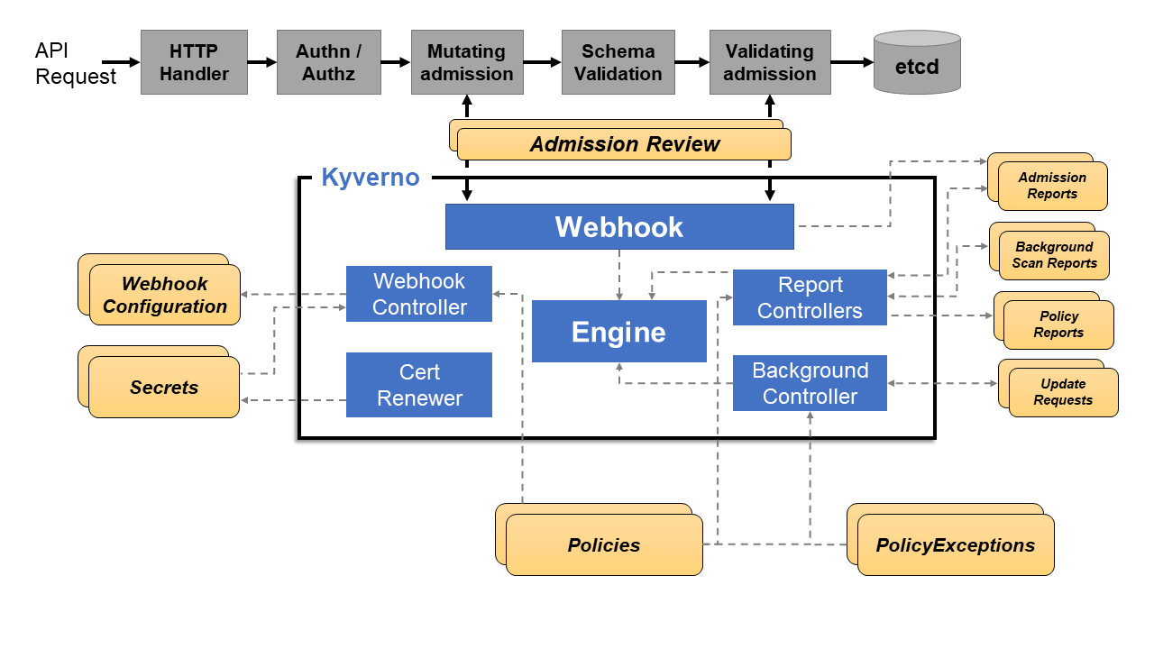
Appendix
Kyverno Architecture [7]

