Slide 1
Kyverno Workshop
KCD Bangalore 2023
presented by Nirmata

Slide 2
Welcome!

Slide 3
Prerequisites
}
kubectl
KinD/K3d/Minikube
git
helm
crane
krew (krew.sigs.k8s.io)
IDE (Visual Studio Code recommended)
* Recommended, not required
bat
yq
jq
Docker Desktop
brew

Slide 4
What We’re Doing Here
What’s this all about?
Understanding the uses for policy
Understanding Kubernetes better
Getting started with Kyverno
What will I take away?
Why policy is necessary
How policy is implemented in Kubernetes
Solid foundation of Kyverno
Identify common use cases from the field
Real policy in labs to solve your own use cases
No “hello world” here
Not covering
Guts of Kyverno’s inner workings
All policy authoring
Advanced topics
1.10 beta features

Slide 5
About Us
Anusha Hegde
Technical Product Manager
Nirmata
Kumar Mallikarjuna
Software Engineer
Nirmata
https://twitter.com/hegdeanusha25
https://twitter.com/kr_mallikarjuna
https://www.linkedin.com/in/anusha-hegde-6468897a
https://www.linkedin.com/in/kumarmallikarjuna

Slide 6
Agenda
The need for policies and what are they
Kyverno Installation and Policy Overview
What are Policy Reports
BREAK (5 mins)
Pod Security Admission (Lab)
Best Practices in Kubernetes (Lab)
BREAK (5 mins)
Supply Chain Security with Kyverno
Image signing and Verification (Lab)
How does Kyverno help with Multitenancy
Namespace as a Service (Lab)
BREAK (5 mins)
The most loved Policy Exceptions
Real time use cases for exceptions (Lab)
Using Kyverno to cleanup resources (Lab)
BREAK (5 mins)
How Nirmata can help
Closing Thoughts
Final Q & A

Slide 7
Introduction
Notes:
Arjun - 15-20 mins

Slide 8
Why do we need policy?
You don’t… until other people get involved
Bad things happen (e.g., security breaches)
on purpose
accidental
People make mistakes
Tribal knowledge is compartmentalized
Kubernetes is hard!
Policy
✅ Reduces risk
✅ Sets expectations of others
✅ Creates consistency
✅ Saves time

Slide 9
What can policy, generally, do for us?
Policy is a set of rules that can
Define “law” or guardrails (Security)
Ensure consistency (Governance)
Provide feedback (Observability)
Perform tasks (Automation)
Functions as a contract between teams
Improve security
Eliminate misconfigurations
Provide separation of concerns across roles
Reduce configuration complexity
Promote best practices
Deliver self-service and automation

Slide 10
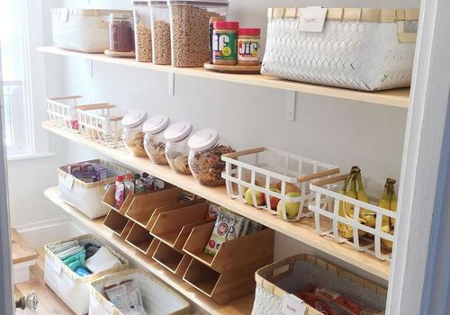
Guardrails in two pictures
This
To this

Slide 11
What can Kyverno, specifically, do for us?
“Govern” in Greek (κυβερνώ)
Validate resources
Mutate resources
Generate (create) new resources
Verify container images to ensure supply chain security
Create reports
Useable in a CI/CD pipeline
Use cases it solves
Pod Security
Additional security validation and enforcement
Fine-grained RBAC
Cost control (no LoadBalancer in cloud)
Operations assistance (Ingress unique hostname)
Multi-tenancy (Namespace provisioning)
Organizational practice adherence (add your org’s labels)
Sidecar (including certificate) injection with mounts, etc.
Supply chain security

Slide 12
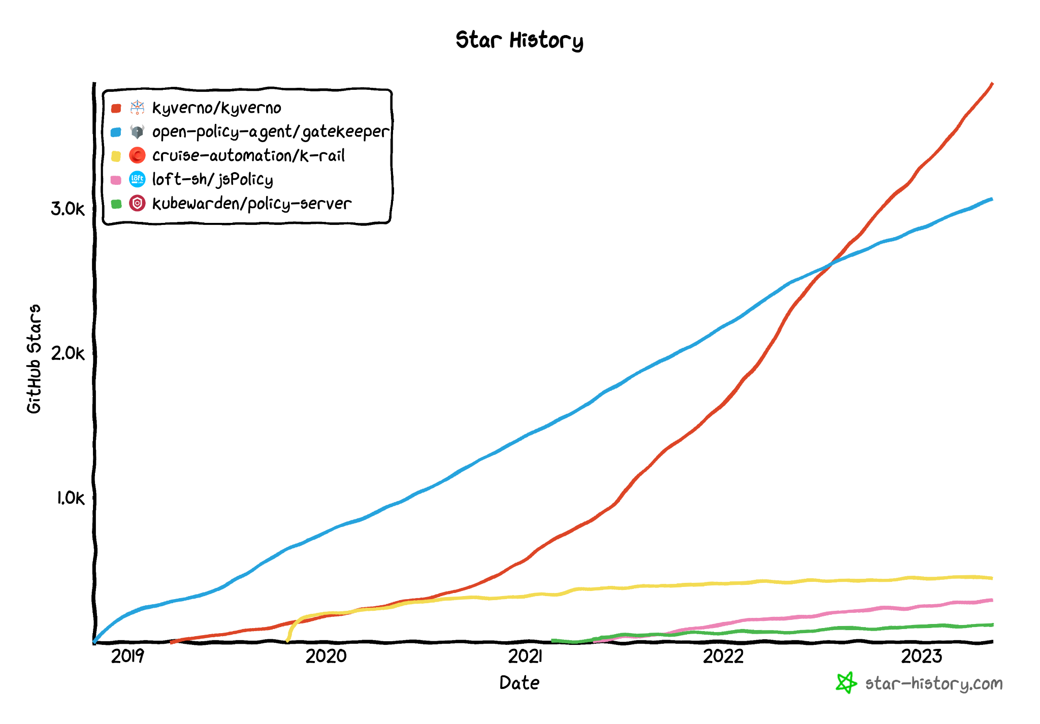
But why Kyverno?
Kubernetes native
No programming language required!!
Policy is easy and writable/comprehensible by everyone
Incubating project in CNCF
One of the fastest growing CNCF projects
Most starred Kubernetes policy engine
Many different capabilities, some unique
Use your existing tools to work with YAML
Reports are decoupled from policies allowing separation of duties
Allows testing in CI/CD pipelines
Most extensive library of any policy engine
Notes:
https://star-history.com/#kyverno/kyverno&open-policy-agent/gatekeeper&cruise-automation/k-rail&loft-sh/jsPolicy&kubewarden/policy-server&Date

Slide 13
How is policy implemented?
In Kubernetes, through Admission Controllers via plug-ins
Only run after authN and authZ
Two types*
Integrated LimitRanger, ResourceQuota, PodSecurity (PSA), etc.
External MutatingAdmissionWebhook, ValidatingAdmissionWebhook
Files (“policies”) describing desired intent
CustomResourceDefinitions (CRDs) (Often)
Controller paradigm
* NetworkPolicy is the domain of the CNI

Slide 14
What’s an Admission Controller?
Program/code loop that can validate or mutate requests (even both!) prior to being “admitted” into the cluster
Registered and sent via webhooks
Resources are sent as AdmissionReview objects
Not all resources are eligible to be sent
Not triggered on reads!
Component of many Kubernetes-native tools, not just policy engines (ex., CNI plug-ins, service meshes, secrets managers, certificate managers, etc.)
Examples of policy engines:
Kyverno
OPA/Gatekeeper
Kubewarden
jsPolicy

Slide 15
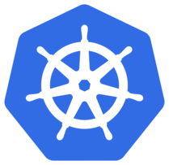
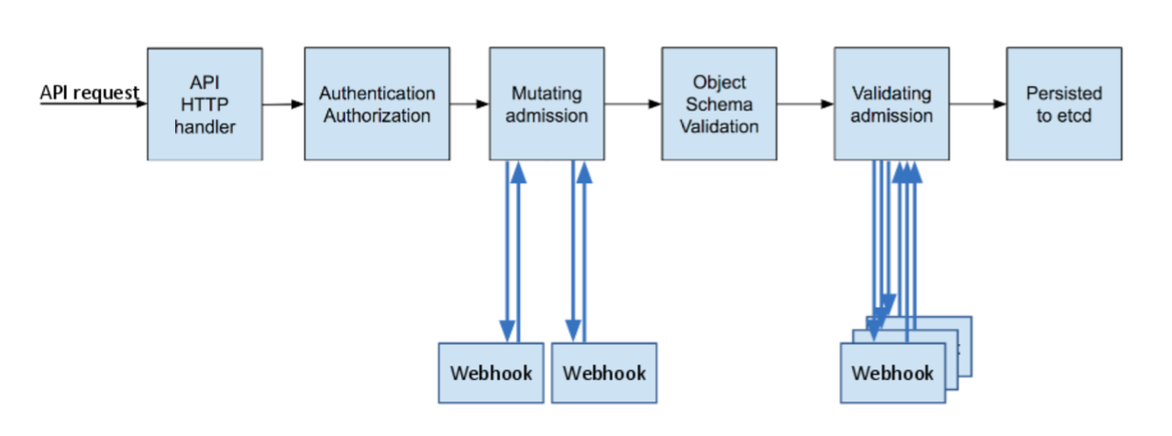
Dynamic Admission Control
(Serial)
(Parallel)

Slide 16
Webhooks (in Kubernetes)
HTTP call-back to cluster services
Just another Kubernetes resource
kubectl get | kubectl explain validatingwebhookconfigurations
kubectl get | kubectl explain mutatingwebhookconfigurations
Describes three main things
WHAT resources should be sent
To WHERE they should be sent
HOW communication should be treated

Slide 17
Example Webhook
apiVersion: admissionregistration.k8s.io/v1 kind: ValidatingWebhookConfiguration metadata: name: kyverno-resource-validating-webhook-cfg webhooks: - admissionReviewVersions: - v1beta1 clientConfig: caBundle: <base64_encoded_cert_goes_here> service: <== ### Send things to me at this location name: kyverno-svc namespace: kyverno path: /validate port: 443 failurePolicy: Fail <== #### If you don’t hear back, do this. matchPolicy: Equivalent name: validate.kyverno.svc-fail namespaceSelector: matchExpressions: - key: kubernetes.io/metadata.name operator: NotIn values: - kyverno objectSelector: {} rules: <== #### Send me these things - apiGroups: - "" apiVersions: - v1 operations: - CREATE - UPDATE - DELETE - CONNECT resources: - namespaces scope: '*' sideEffects: NoneOnDryRun timeoutSeconds: 10 <== #### Wait this long to hear from me.

Slide 18
AdmissionReview
kind: AdmissionReview apiVersion: admission.k8s.io/v1beta1 request: uid: decbd0f7-8ba5-4a04-9550-9e4e581fc52a kind: group: "" version: v1 kind: ResourceQuota resource: group: "" version: v1 resource: resourcequotas requestKind: group: "" version: v1 kind: ResourceQuota requestResource: group: "" version: v1 resource: resourcequotas name: gemini-rq namespace: default operation: CREATE userInfo: username: system:admin groups: - system:masters - system:authenticated object: kind: ResourceQuota apiVersion: v1 metadata: name: gemini-rq namespace: default uid: de900165-a091-44ec-92a0-40d705c5bff2 creationTimestamp: "2022-07-17T23:01:58Z" annotations: kubectl.kubernetes.io/last-applied-configuration: | {<snip>} managedFields: {<snip>} spec: hard: limits.cpu: "8" limits.memory: 32Gi requests.cpu: "8" requests.memory: 32Gi status: {} oldObject: null dryRun: false options: kind: CreateOptions apiVersion: meta.k8s.io/v1 fieldManager: kubectl-client-side-apply
apiVersion: v1 kind: ResourceQuota metadata: name: gemini-rq spec: hard: requests.cpu: "8" requests.memory: 32Gi limits.cpu: "8" limits.memory: 32Gi
⇐ You send this
Admission controller receives this ⇒
Operations
CREATE
UPDATE
DELETE
CONNECT

Slide 19
Summary
Policy is mandatory especially in production
Custom policy is implemented via Admission Controls
Webhooks are the “bridge” mechanism
Kyverno has lowest cost, highest return
Everything comes packaged as AdmissionReview

Slide 20
Installation &
Policy Overview
Notes:
Anusha - 20mins

Slide 21
Installation
Kyverno runs intra-cluster
High Availability @ 3 replicas
Pod anti-affinity
PodDisruptionBudget
Helm recommended method (easiest, production)
Raw YAML manifest available (testing only)
helm install kyverno kyverno/kyverno -n kyverno --create-namespace

Slide 22
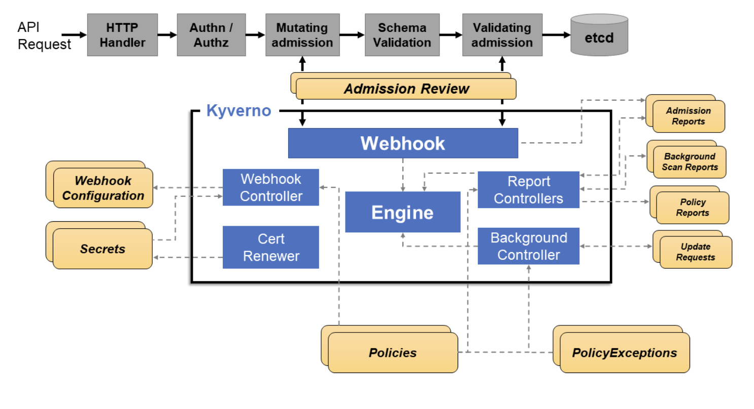
Kyverno High Level Architecture

Slide 23
Policy as CRDs
Two CRDs for policy
Policy <- Namespaced policy
ClusterPolicy <- Cluster-scoped policy
OpenAPIv3 compliant
Fully described (kubectl explain)
Use Kubernetes RBAC to control
Policy ⇒ Webhooks
failurePolicy
Fail
Ignore
webhookTimeoutSeconds
0-30

Slide 24
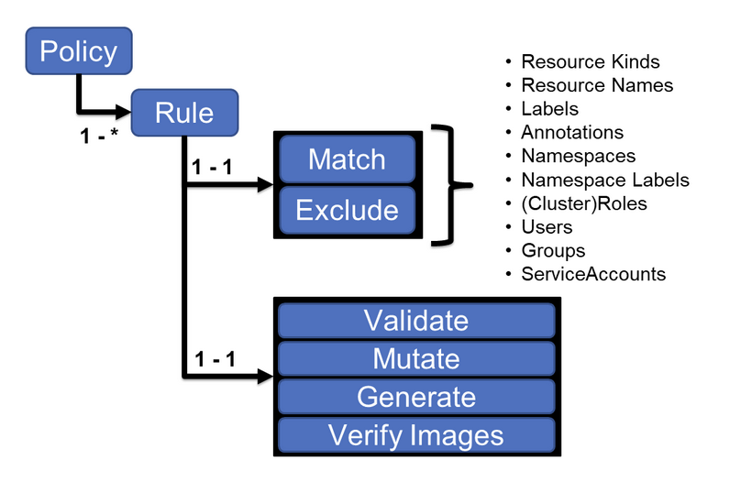
Policy Anatomy

Slide 25
Sample Policy
apiVersion: kyverno.io/v1 kind: ClusterPolicy metadata: name: require-labels spec: validationFailureAction: enforce background: true rules: - name: check-for-team match: any: - resources: kinds: - Pod validate: message: "The label `team` is required." pattern: metadata: labels: team: "?*"

Slide 26
More Policy Behavior
Policy serves as logical “container” for rules*
Some fields control behavior at spec may determine
validationFailureAction, background, failurePolicy
Rules applied in policy definition order
One rule cannot override/countermand another
All mutation rules apply first regardless
Common to organize rules into policies if tightly related
* Some exceptions, present and future, apply

Slide 27
Selecting Resources
Resource selection is done per rule
A match block is required. exclude is optional.
Matching is highly flexible
Roles and ClusterRoles are determined by Kyverno
Advanced control using any or all
Most common selection/exclusion using resources
Supports wildcards (foo-*)

Slide 28
Lab

Slide 29
Reports
Reports show results of validate rules when the (Cluster)Policy they’re in are set to audit mode
Blocked resources excluded
Two types of CRDs
PolicyReport (for Namespaced resources)
ClusterPolicyReport (for cluster-scoped resources)
Type of report not related to where rule is found
Uses open standard from Kubernetes Policy WG
Results are pass, fail, warn, error, and skip

Slide 30
Reports (continued)
Reports are automatically created and updated
Deleted? Kyverno recreates.
Entries created upon AdmissionReview
Entries deleted upon resource/policy removal
Apply to pre-existing resources?
spec.background to true*
kubectl describe polr polr-ns-default -n default
* Limitations apply. See documentation.

Slide 31
Example Policy Report
apiVersion: wgpolicyk8s.io/v1alpha2 <== ### Kubernetes policy working group API kind: PolicyReport <== ### (Namespaced) PolicyReport metadata: labels: managed-by: kyverno name: polr-ns-default namespace: default <== ### In the `default` Namespace results: - message: validation rule 'secrets-not-from-env-vars' passed. <== ### Will show rule’s failure message if failed. policy: secrets-not-from-env-vars <== ### Policy name resources: <== ### The resource in this entry - apiVersion: v1 kind: Pod name: busybox namespace: default uid: 056d4cb6-f772-4813-bea6-604337c17811 result: pass <== ### This passed the rule so result is `pass` rule: secrets-not-from-env-vars <== ### The rule name within the policy name scored: true source: Kyverno timestamp: nanos: 0 seconds: 1657952322 summary: <== ### Summary of all results in the entire report error: 0 fail: 0 pass: 1 skip: 0 warn: 0

Slide 32
BREAK

Slide 33
Best Practices in Kubernetes
Pod Security Standards
Privileged
Baseline
Restricted
RBAC Best Practices
Multitenancy Best Practices
Supply Chain Security Best Practices
…
Notes:
Anusha - 15mins

Slide 34
Lab

Slide 35
Pod Security Admission
Notes:
Arjun - 25mins

Slide 36
Pod Security in Kubernetes
Pod Security Policies (PSPs) were removed starting K8s 1.25. PSPs were designed to control the security specification of Pods. However, they were not intuitive to use. They're now replaced by Pod Security Admission (PSAs) which help enforce Pod Security Standards (PSSs) on a namespace level.
Pod Security Standards define three policies to broadly cover the security spectrum:
privileged
Anything is allowed!
Unrestricted
System & Infra-level workloads
baseline
Minimally restricted
Common workloads
restricted
Heavily restricted
Security critical workloads

Slide 37
Lab

Slide 38
Multitenancy with Kyverno
Notes:
Anusha - 20mins

Slide 39
Namespace as a Service
Shared cluster model
Add guardrails to your namespaces
ResourceQuota
LimitRange
NetworkPolicy
…
Provide self service for your developers

Slide 40
Generation Rules
Create new resources based on triggers (unique)
CREATE, UPDATE, and DELETE
Supports Custom Resources too!
New resource definition can be
Defined in the policy (data type)
Cloned from an existing resource (clone type)
Synchronization allows changes to be propagated
Most common use cases
Multi-tenancy / NaaS
Secret etc resource synchronization across Namespaces
Generate works on existing items!

Slide 41
Generate Examples
apiVersion: kyverno.io/v1 kind: ClusterPolicy metadata: name: add-networkpolicy spec: rules: - name: default-deny match: resources: kinds: - Namespace generate: apiVersion: networking.k8s.io/v1 kind: NetworkPolicy name: default-deny namespace: "{{request.object.metadata.name}}" synchronize: true data: <== ### Target defined below spec: podSelector: {} policyTypes: - Ingress - Egress
apiVersion: kyverno.io/v1 kind: ClusterPolicy metadata: name: sync-secrets spec: rules: - name: sync-image-pull-secret match: resources: kinds: - Namespace generate: apiVersion: v1 <== ### apiVersion of gen. resource kind: Secret <== ### Kind of gen. resource name: regcred <== ### Name of gen. resource namespace: "{{request.object.metadata.name}}" synchronize: true clone: <== ### Target copy from source namespace: default name: regcred

Slide 42
Generation Behavior
When trigger is matched, UpdateRequest (CR) created
Deleted after successful target creation
Kyverno must have permissions to create your resource
Deleting a policy using data will cause target deletion
Deleting trigger will not cause deletion of target*
Deleting a generated resource where synchronize: true will cause immediate recreation
Variables from AdmissionReview are essential
* This is possible to configure, however. See docs for procedure.

Slide 43
Lab

Slide 44
Supply Chain Security
Notes:
Anusha - 25mins

Slide 45
Image Verification Rules
Rules which check container images
Signatures
Attestations
Ensures supply chain security
Images are signed with expected key/metadata
Attestations: Provenance, SBOM, vuln. scans, custom, etc.
Uses Sigstore Cosign
Attestations in in-toto format
Indicated by rule type verifyImages
Runs during mutation and validation admission phases

Slide 46
Image Verification Features
Signing verification (attestors) using key, cert, keyless
Mutates tag => digest
Any OCI registry supported
Supports private registries (imagePullSecret)
KMS supported
Supports annotation verification
Any attestation, any portion
Multi-way checks (any, all, at-least)
E.g., Org must sign and team must also sign, different keys

Slide 47
Image Verification Examples - Signature
apiVersion: kyverno.io/v1 kind: ClusterPolicy metadata: name: check-image spec: validationFailureAction: enforce background: false webhookTimeoutSeconds: 30 <== ### Length of time to wait before delivering a response failurePolicy: Fail <== ### Fail the request if this rule can’t be evaluated rules: - name: check-image match: any: - resources: kinds: - Pod verifyImages: <== ### This is a verifyImages rule type - imageReferences: - "ghcr.io/kyverno/test-verify-image:*" <== ### Only perform this verification on these images attestors: <== ### Who/what is providing the signature - count: 1 entries: - keys: <== ### A specific key will be used publicKeys: |- <== ### Use this public key to verify the specified image(s) -----BEGIN PUBLIC KEY----- MFkwEwYHKoZIzj0CAQYIKoZIzj0DAQcDQgAE8nXRh950IZbRj8Ra/N9sbqOPZrfM 5/KAQN0/KjHcorm/J5yctVd7iEcnessRQjU917hmKO6JWVGHpDguIyakZA== -----END PUBLIC KEY-----

Slide 48
Lab

Slide 49
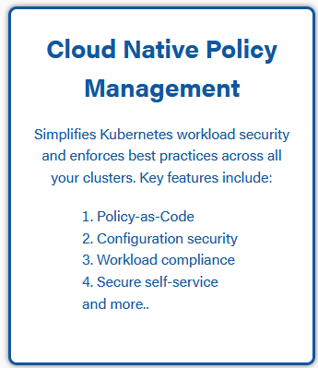
For Module 9
Sign up:
try.nirmata.io
Problems?
ritesh@nirmata.com
BREAK

Slide 50
Policy Exceptions
Notes:
Arjun - 10mins

Slide 51
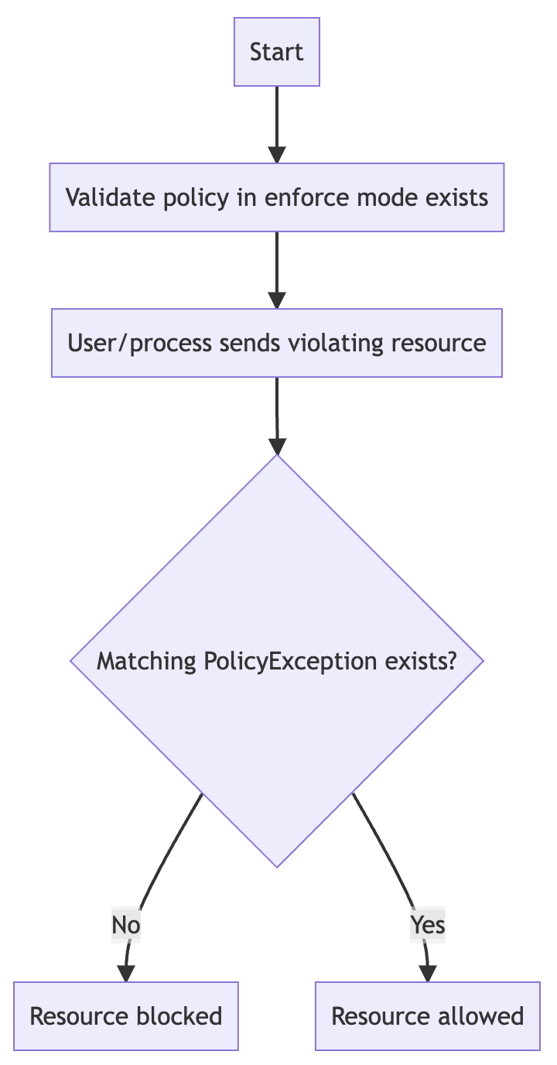
Policy Exceptions
Kyverno Policies can have controls are intended to exclude resources but they must occur in the same rule definition.
This may be limiting in situations where policies may not be directly editable, or doing so imposes an operational burden.
To tackle this, Kyverno has the Namespaced Policy Exceptions CRD.
<namespace>/<policy-name>

Slide 52
Policy Exceptions
Uses the following fields:
match/exclude similar as in Policy and ClusterPolicy resources
exceptions{} object to select the policy and rule name(s) used to form the exception

Slide 53
Lab

Slide 54
Cleanup Policies
Notes:
Arjun - 10mins

Slide 55
Cleanup Policies
Kyverno has the ability to cleanup (i.e., delete) existing resources in a cluster defined in a new policy called a CleanupPolicy.
Comes in both cluster-scoped and Namespaced flavors: (Cluster)CleanupPolicy.

Slide 56
Cleanup Policies
Uses the following fields:
match/exclude block to select and exclude resources which are subjected to the cleanup process
conditions{} block (optional) uses common expressions similar to those found in preconditions and deny rules to query the contents of the selected resources in order to refine the selection process.
schedule defines, in cron format, when the rule should run.

Slide 57
Nirmata Policy Manager
Notes:
Anusha - 10mins

Slide 58
Nirmata Policy Manager
Multi-cluster manager for Kyverno
Curated Policy Sets
Multi-cluster rollout
Add your own from git or raw YAML files
Estate view of stats and Policy Reports
Scheduled
Monitoring and metrics
RBAC for cross-team collaboration
Teams, SAML, OIDC, MFA
Integrations with other tools (Slack, Jira, etc)
Alarms and notifications
Compliance standards

Slide 59
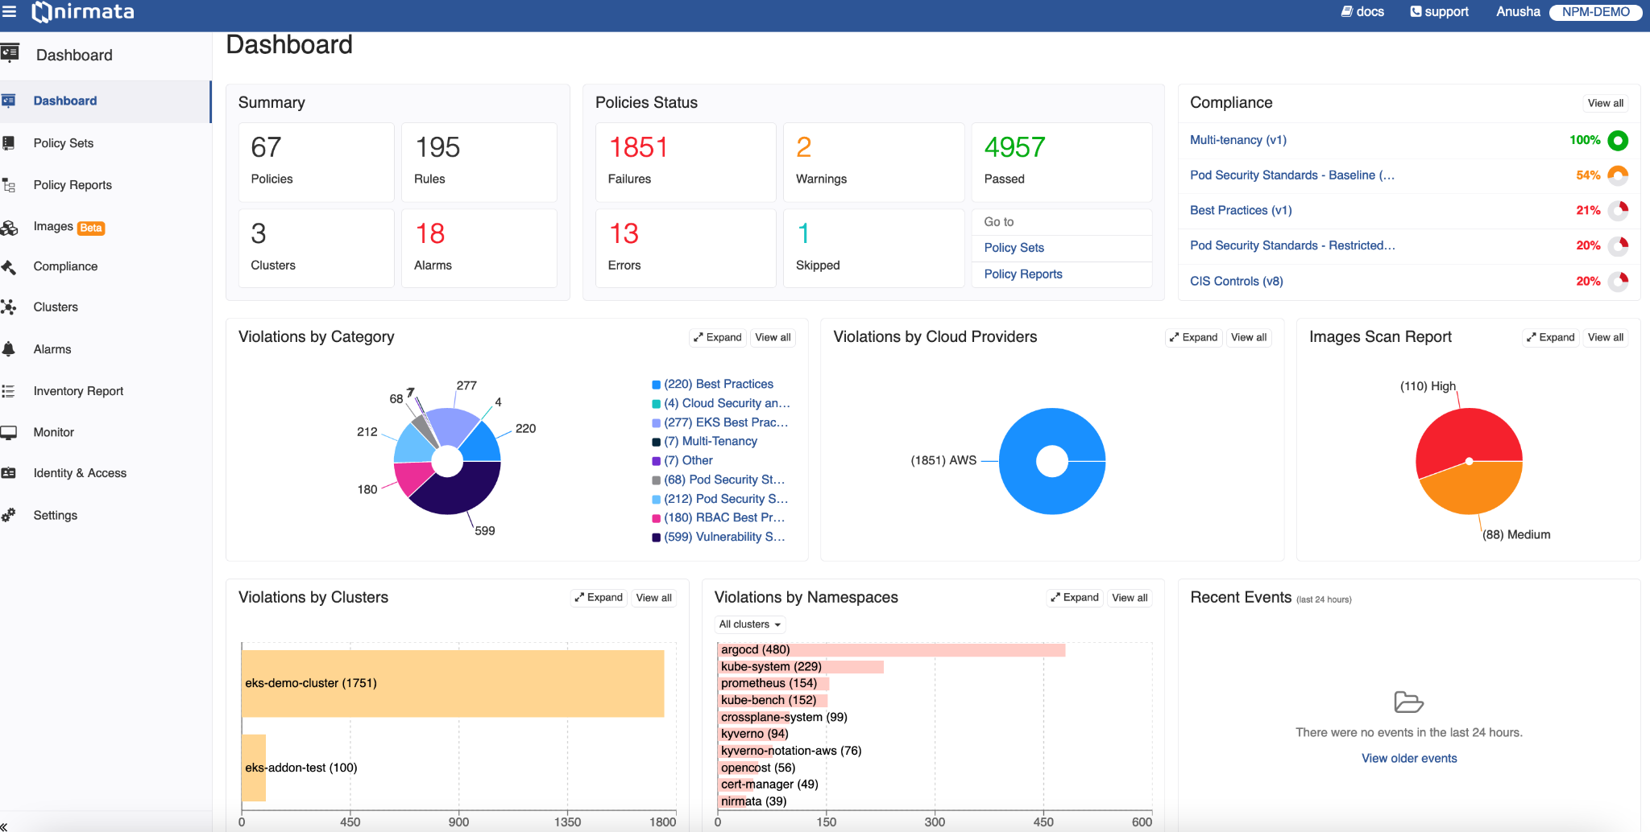
Dashboard

Slide 60
Closing Thoughts

Slide 61
So much to cover, so little time…
So much to talk about, we missed these:
JMESPath
API calls
Context variables
Image registry data
Auto-generation
Monitoring
Latest features in Kyverno 1.10
Please see the docs (https://kyverno.io/docs/)!

Slide 62
Resources
Resource | Address
Documentation | https://kyverno.io
Sample Policies | https://kyverno.io/policies
Contributing | https://github.com/kyverno/kyverno#-contributing
Kyverno Design Proposals | https://github.com/kyverno/KDP
Policy Reporter | https://github.com/kyverno/policy-reporter
#kyverno on Kubernetes Slack | https://kubernetes.slack.com/archives/CLGR9BJU9
Nirmata Policy Manager | https://nirmata.com/nirmata-cloud-native-policy-manager
Kyverno vs OPA/Gatekeeper | https://neonmirrors.net/post/2021-02/kubernetes-policy-comparison-opa-gatekeeper-vs-kyverno

Slide 63
Final Q & A
AMA

Slide 64
Thank you for attending!

