Slide 2
Kubernetes Security: Navigating the real-world challenges
Anusha Hegde,
Technical Product Manager @ Nirmata

Slide 3
Kubernetes is complex to secure & scale
Sources: cve.mitre.org; Red Hat’s “2022 state of Kubernetes security report”
180%
93%
#1
increase in security issues in 2022
reported a security incident
misconfigurations are the leading cause
Kubernetes instances found exposed online
The results from research by Cyble show a massive 900,000 Kubernetes servers, with 65% of them (585,000) being located in the United States, 14% in China, 9% in Germany, while Netherlands and Ireland accounted for 6% each.
Tesla Kubernetes resources hacked to run crypto-mining malware
"The hackers had infiltrated Tesla's Kubernetes console which was not password protected," RedLock researchers wrote. "Within one Kubernetes pod, access credentials were exposed to Tesla's AWS environment which contained an Amazon S3 (Amazon Simple Storage Service) bucket that had sensitive data such as telemetry."

Slide 4
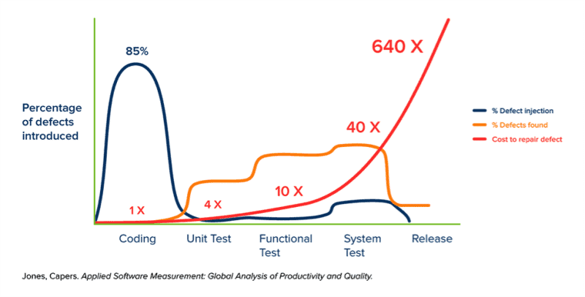
The Cost of missing K8s Guardrails
Phase | Pre-deploy | Production
Cost per defect | $25 | $15,903
Cost per cluster | $8151 | $5,216,193
https://www.cncf.io/blog/2022/02/02/the-cost-of-a-kubernetes-repair-in-development-vs-production/

Slide 5
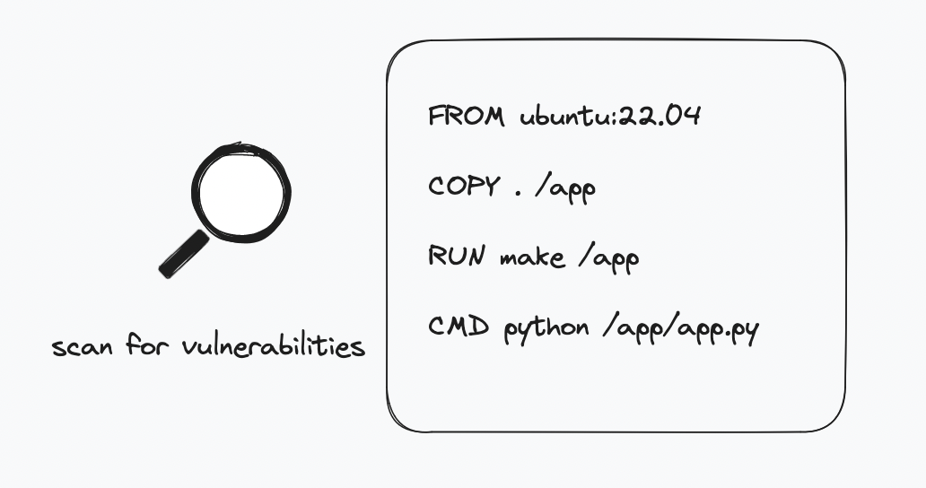
The Most Common Security Measure

Slide 6
Is it enough?

Slide 7
The Most Common Security Assumption
My cloud-provider has got my back!

Slide 8
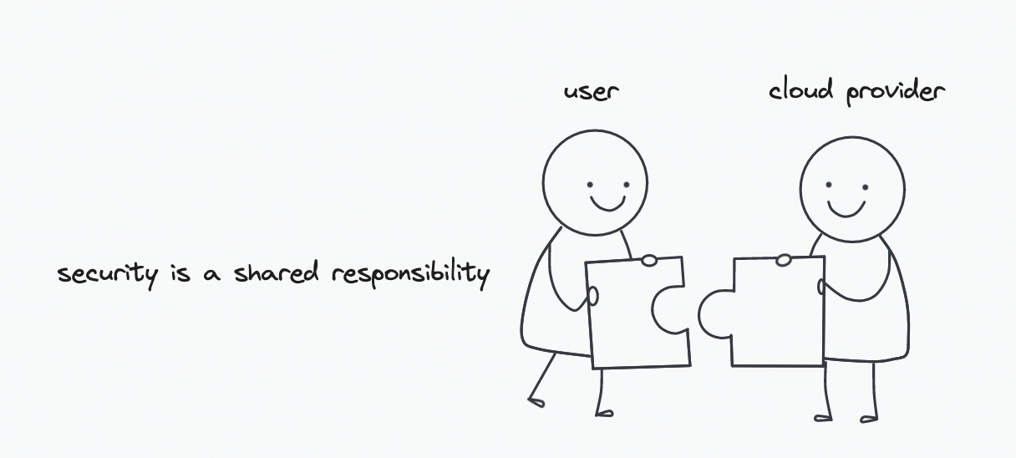
Whose responsibility is it anyway?

Slide 9
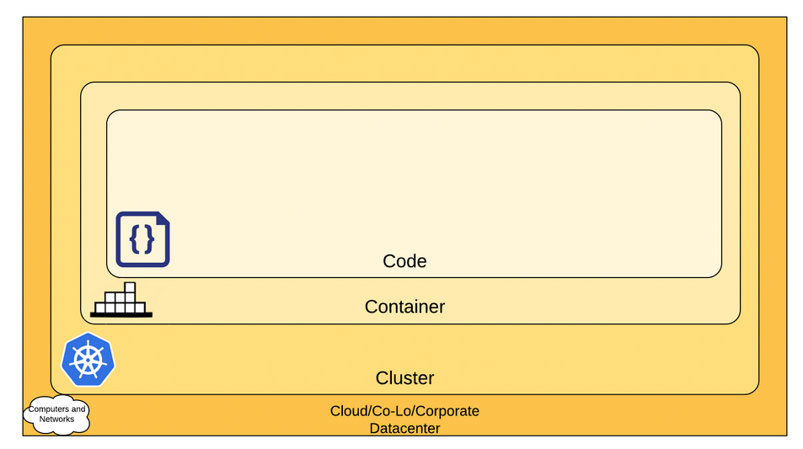
The 4Cs of Cloud-Native Security
Each layer of the Cloud Native security model builds upon the next outermost layer.
https://kubernetes.io/docs/concepts/security/overview/#the-4c-s-of-cloud-native-security

Slide 10
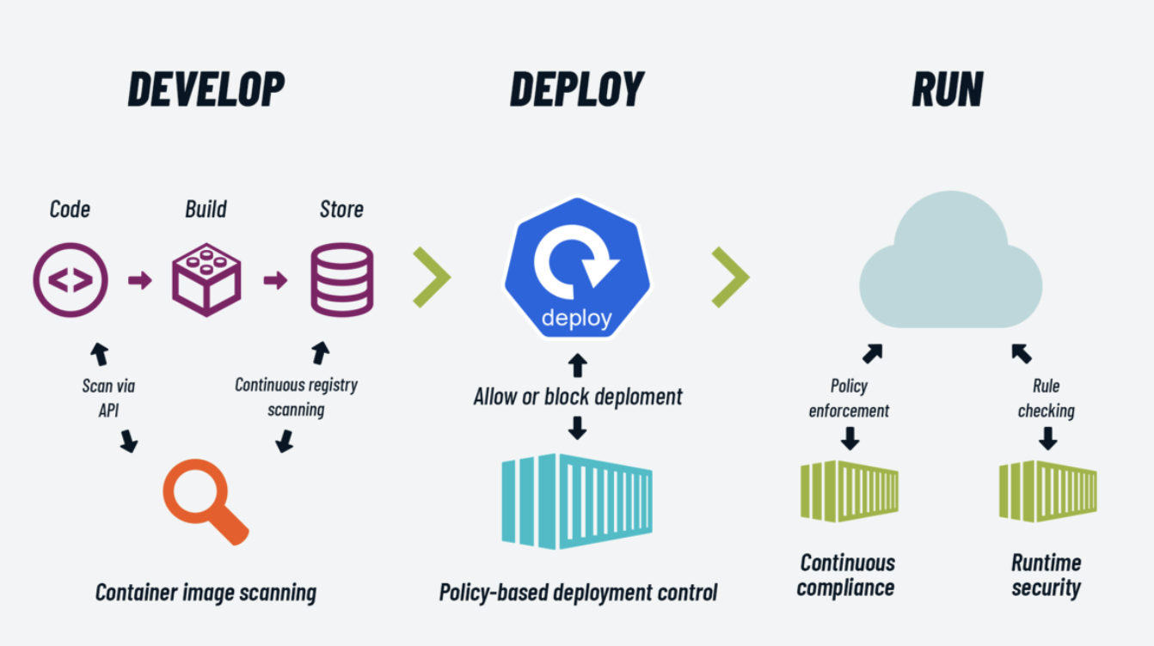
Cloud-native Attack Surface
Development Teams
CICD/DevOps Teams
SRE/Platform Teams

Slide 11
Securing the Cloud-native Attack Surface
Development Teams
CICD/DevOps Teams
SRE/Platform Teams

Slide 12
Tools Used across the cloud-native
Lifecycle
gosec
dependabot

Slide 13
Security across the cloud-native Lifecycle
Identify misconfigurations & scan package dependencies
Validate manifests and images at admission control
Commit
Build
Deploy
Run
Verify, sign and attest images in CICD workflows
Detect new issues with continuous background scans

Slide 14
THANK YOU…!!!

